Slide 1

ViMMS: A framework to develop, test and optimise fragmentation strategies in LC-MS/MS metabolomics
Dr Vinny Davies

Slide 2

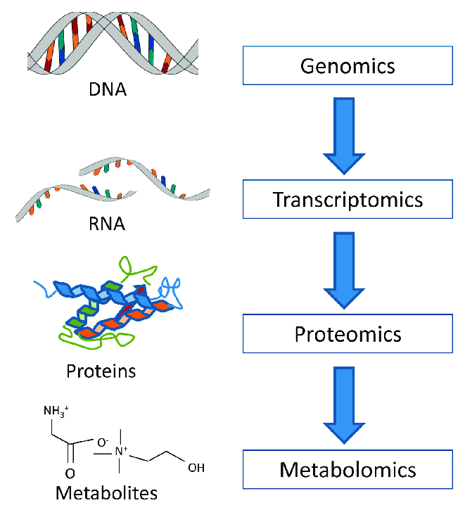
What is Metabolomics?
Metabolomics is the "systematic study of the unique chemical fingerprints that specific cellular processes leave behind", the study of their small-molecule metabolite profiles.
Basically, we are trying to identify all the metabolites in a particular sample

Slide 3
Data acquisition in LC-MS/MS metabolomics
Metabolomics experiments often rely on data collected through Liquid Chromatograph tandem mass spectrometry experiments (LC-MS/MS)
In a standard experiment these rely on data acquisition approaches such as Data Dependent Acquisition (DDA) and Data Independent Acquisition (DIA)
Little work has been done to optimise and improve these processes
My work is focused around designing new strategies for data acquisition

Slide 4
Metabolomics Mass Spectrometry Experiments
Samples can be extremely varied, but standard option is blood, urine, etc – We use beer!
No data protection issues
Cheap and easily available
Similar enough for method development

Slide 5
Metabolomics Mass Spectrometry Experiments
Samples can be extremely varied, but standard option is blood, urine, etc – We use beer!
No data protection issues
Cheap and easily available
Similar enough for method development
Ionisation

Slide 6
Metabolomics Mass Spectrometry Experiments
Samples can be extremely varied, but standard option is blood, urine, etc – We use beer!
No data protection issues
Cheap and easily available
Similar enough for method development
Mass Spectrometer
Ionisation

Slide 7
Metabolomics Mass Spectrometry Experiments
Samples can be extremely varied, but standard option is blood, urine, etc – We use beer!
No data protection issues
Cheap and easily available
Similar enough for method development
Mass Spectrometer
Intensity
Ionisation
m/z

Slide 8
LC-MS/MS
MS
scans
Sample
Sample fraction, collected in small time period
Mass (per charge)
Chromatographic peaks
intensity
Chromatographic retention time
retention time

Slide 9
Scan Types – MS1
MS1 scan
Measures mass (per charge), and intensity (how many copies of the molecule)
Scan also has an associated retention time
mass isn’t enough to identify the molecule

Slide 10
Scan Types – MS2
Fragmentation: smashing up a molecule
MS
MS2 spectra can be used as a molecular fingerprint to identify molecules
Spectra are compared against a database of spectra for known molecules

Slide 11
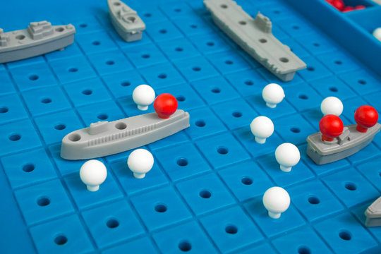

Data acquisition as a game of Battleships?
I like to compare the data acquisition process in LC-MS/MS to a game of Battleships…
My version of battleships varies somewhat from the game
It’s a hybrid between, real life bombing raids, battleships the game & chemistry
It will all make sense soon (hopefully!!!)

Slide 12
How is this a game of Battleships?
 | 1 | 2 | 3 | 4 | 5 | 6 | 7 | 8 | 9 | 10
A
B
C
D
E
F
G
H
I
J
Mass (per charge)
Chromatographic retention time

Slide 13
What are the rules of metabolomics Battleships?!
Firstly, all our ships need to be horizontal
 | 1 | 2 | 3 | 4 | 5 | 6 | 7 | 8 | 9 | 10
A
B
C
D
E
F
G
H
I
J
 | 1 | 2 | 3 | 4 | 5 | 6 | 7 | 8 | 9 | 10
A
B
C
D
E
F
G
H
I
J

Slide 14

What are the rules of metabolomics Battleships?!
Our planes all travel horizontally (once – for now)
 | 1 | 2 | 3 | 4 | 5 | 6 | 7 | 8 | 9 | 10
A
B
C
D
E
F
G
H
I
J

Slide 15
What are the rules of metabolomics Battleships?!
Like in battleships, all the ships are hidden
 | 1 | 2 | 3 | 4 | 5 | 6 | 7 | 8 | 9 | 10
A
B
C
D
E
F
G
H
I
J
 | 1 | 2 | 3 | 4 | 5 | 6 | 7 | 8 | 9 | 10
A
B
C
D
E
F
G
H
I
J

Slide 16
What are the rules of metabolomics Battleships?!
We can mix radar scans (MS1 scans) with dropping a single bomb (MS2 scan)
 | 1 | 2 | 3 | 4 | 5 | 6 | 7 | 8 | 9 | 10
A
B
C
D
E
F
G
H
I
J

Slide 17
What are the rules of metabolomics Battleships?!
We can mix radar scans (MS1 scans) with dropping a single bomb (MS2 scan)
 | 1 | 2 | 3 | 4 | 5 | 6 | 7 | 8 | 9 | 10
A
B
C
D
E
F
G
H
I
J
Our radar sees nothing, so we do another radar scan next

Slide 18
What are the rules of metabolomics Battleships?!
We can mix radar scans (MS1 scans) with dropping a single bomb (MS2 scan)
 | 1 | 2 | 3 | 4 | 5 | 6 | 7 | 8 | 9 | 10
A
B
C
D
E
F
G
H
I
J

Slide 19
What are the rules of metabolomics Battleships?!
We can mix radar scans (MS1 scans) with dropping a single bomb (MS2 scan)
 | 1 | 2 | 3 | 4 | 5 | 6 | 7 | 8 | 9 | 10
A
B
C
D
E
F
G
H
I
J
Our radar sees 2 ships, so we will schedule 2 bombs for our next times.

Slide 20
What are the rules of metabolomics Battleships?!
We can mix radar scans (MS1 scans) with dropping a single bomb (MS2 scan)
 | 1 | 2 | 3 | 4 | 5 | 6 | 7 | 8 | 9 | 10
A
B
C
D
E
F
G
H
I
J

Slide 21
What are the rules of metabolomics Battleships?!
We can mix radar scans (MS1 scans) with dropping a single bomb (MS2 scan)
 | 1 | 2 | 3 | 4 | 5 | 6 | 7 | 8 | 9 | 10
A
B
C
D
E
F
G
H
I
J
We drop a bomb on our first ship – we do not know (in real time) if it hits (it has and sinks)

Slide 22
What are the rules of metabolomics Battleships?!
We can mix radar scans (MS1 scans) with dropping a single bomb (MS2 scan)
 | 1 | 2 | 3 | 4 | 5 | 6 | 7 | 8 | 9 | 10
A
B
C
D
E
F
G
H
I
J
Bombing a ship is equivalent to getting a fragmentation spectra for a metabolite
This helps us identify the metabolite
Intensity (how much)
Mass (per unit charge)

Slide 23
What are the rules of metabolomics Battleships?!
We can mix radar scans (MS1 scans) with dropping a single bomb (MS2 scan)
 | 1 | 2 | 3 | 4 | 5 | 6 | 7 | 8 | 9 | 10
A
B
C
D
E
F
G
H
I
J

Slide 24
What are the rules of metabolomics Battleships?!
We can mix radar scans (MS1 scans) with dropping a single bomb (MS2 scan)
 | 1 | 2 | 3 | 4 | 5 | 6 | 7 | 8 | 9 | 10
A
B
C
D
E
F
G
H
I
J
We drop a bomb on our second ship – we do not know if it hits (it hasn’t, the ship was too small)

Slide 25
What are the rules of metabolomics Battleships?!
We can mix radar scans (MS1 scans) with dropping a single bomb (MS2 scan)
 | 1 | 2 | 3 | 4 | 5 | 6 | 7 | 8 | 9 | 10
A
B
C
D
E
F
G
H
I
J

Slide 26
What are the rules of metabolomics Battleships?!
We can mix radar scans (MS1 scans) with dropping a single bomb (MS2 scan)
 | 1 | 2 | 3 | 4 | 5 | 6 | 7 | 8 | 9 | 10
A
B
C
D
E
F
G
H
I
J
We completed 2 bomb drops, so we go back to a radar scan.
We see 3 ships and we schedule our next 2 bombs (max 2 bombs dropped per radar scan)

Slide 27
What are the rules of metabolomics Battleships?!
We can mix radar scans (MS1 scans) with dropping a single bomb (MS2 scan)
 | 1 | 2 | 3 | 4 | 5 | 6 | 7 | 8 | 9 | 10
A
B
C
D
E
F
G
H
I
J

Slide 28
What are the rules of metabolomics Battleships?!
We can mix radar scans (MS1 scans) with dropping a single bomb (MS2 scan)
 | 1 | 2 | 3 | 4 | 5 | 6 | 7 | 8 | 9 | 10
A
B
C
D
E
F
G
H
I
J
Generally, hitting a ship twice does not help us

Slide 29
What are the rules of metabolomics Battleships?!
We can mix radar scans (MS1 scans) with dropping a single bomb (MS2 scan)
 | 1 | 2 | 3 | 4 | 5 | 6 | 7 | 8 | 9 | 10
A
B
C
D
E
F
G
H
I
J

Slide 30
What are the rules of metabolomics Battleships?!
We can mix radar scans (MS1 scans) with dropping a single bomb (MS2 scan)
 | 1 | 2 | 3 | 4 | 5 | 6 | 7 | 8 | 9 | 10
A
B
C
D
E
F
G
H
I
J

Slide 31
What are the rules of metabolomics Battleships?!
We can mix radar scans (MS1 scans) with dropping a single bomb (MS2 scan)
 | 1 | 2 | 3 | 4 | 5 | 6 | 7 | 8 | 9 | 10
A
B
C
D
E
F
G
H
I
J

Slide 32
What are the rules of metabolomics Battleships?!
We can mix radar scans (MS1 scans) with dropping a single bomb (MS2 scan)
 | 1 | 2 | 3 | 4 | 5 | 6 | 7 | 8 | 9 | 10
A
B
C
D
E
F
G
H
I
J

Slide 33
What are the rules of metabolomics Battleships?!
We can mix radar scans (MS1 scans) with dropping a single bomb (MS2 scan)
 | 1 | 2 | 3 | 4 | 5 | 6 | 7 | 8 | 9 | 10
A
B
C
D
E
F
G
H
I
J

Slide 34
What are the rules of metabolomics Battleships?!
We can mix radar scans (MS1 scans) with dropping a single bomb (MS2 scan)
 | 1 | 2 | 3 | 4 | 5 | 6 | 7 | 8 | 9 | 10
A
B
C
D
E
F
G
H
I
J

Slide 35
What are the rules of metabolomics Battleships?!
We can mix radar scans (MS1 scans) with dropping a single bomb (MS2 scan)
 | 1 | 2 | 3 | 4 | 5 | 6 | 7 | 8 | 9 | 10
A
B
C
D
E
F
G
H
I
J

Slide 36
What are the rules of metabolomics Battleships?!
We can mix radar scans (MS1 scans) with dropping a single bomb (MS2 scan)
 | 1 | 2 | 3 | 4 | 5 | 6 | 7 | 8 | 9 | 10
A
B
C
D
E
F
G
H
I
J

Slide 37
What are the rules of metabolomics Battleships?!
We can mix radar scans (MS1 scans) with dropping a single bomb (MS2 scan)
 | 1 | 2 | 3 | 4 | 5 | 6 | 7 | 8 | 9 | 10
A
B
C
D
E
F
G
H
I
J

Slide 38

ViMMS
ViMMS is a Virtual Metabolomics Mass Spectrometer
It allows you to simulate full metabolomics LC-MS/MS experiments
MS1 and MS2 capabilities, with potential for MSN
ViMMS is implemented within Python and is full open source available at https://github.com/glasgowcompbio/vimms
Wandy, J., Davies, V., et al. (2019). In silico optimization of mass spectrometry fragmentation strategies in metabolomics. Metabolites.
Wandy, J., Davies, V., et al. (2022). ViMMS 2.0: A framework to develop, test and optimise fragmentation strategies in LC-MS metabolomics. JOSS.

Slide 39
What is the point of ViMMS?
ViMMS fully controls scan specifications in real time and allows
Evaluation of existing methods and settings
Develop, evaluate and test new methods
Control MS in real time via an API
Evaluate current tools, e.g. MS-dial
Currently real time control is limited to Thermo Fisher machines with IAPI control

Slide 40
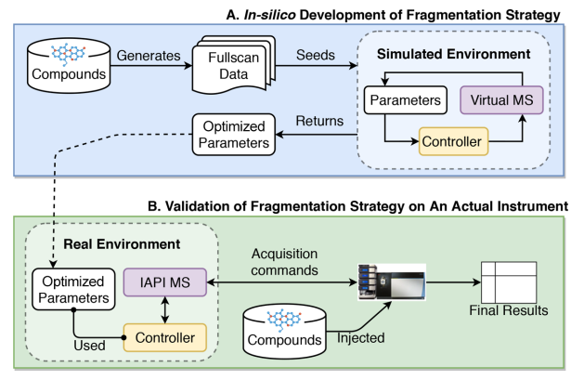
How does ViMMS work?
ViMMS has two environments
Simulated (blue)
Real (green)
The virtual MS (Python code) and real MS (an actual instrument) are interchangeable
Controllers (which schedule scans) are identical in both environments
Samples are either real or virtual

Slide 41
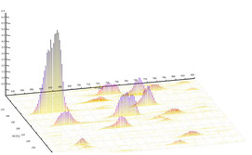
How do the simulations work?
Take an mzml and construct Regions of Interest (ROIs)
ROIs are converted into ViMMS chemicals

Slide 42
How do the simulations work?
Timings for MS1 and MS2 scans are taken directly from the mzml
MS2 spectra are fully synthetic, (e.g. we cannot get new real results)
Standard methods such as Top-N are implemented within ViMMS as controllers (these determine scans)
Results are extracted as mzmls and can analysed in terms of perfomance

Slide 43
How do the real experiments work?
The real experiments works in exactly the same way except using a sample rather than simulated ViMMS chemicals

Slide 44
How do the real experiments work?
Controllers remain consistent across simulated and real experiments
Works through use of Thermo IAPI to control scans in real time (via Python and C# bridging code)
We can use any ViMMS controller on real samples in this manner

Slide 45
What have we used ViMMS to do?
Optimise existing methods
Develop new single-sample DDA methods
Test / develop multi-sample DDA methods
Compare DDA and DIA
Develop new DIA deconvolution methods (ongoing)
Future plans: there are a lots of options. Suggestions very welcome!

Slide 46
Optimising DDA acquisition
A few different DDA methods are currently implemented within ViMMS
We can use the simulated environment to test different parameter settings on a previously collected sample
Advantage: No machine time or sample costs. Optimised performance for next DDA acquisition

Slide 47
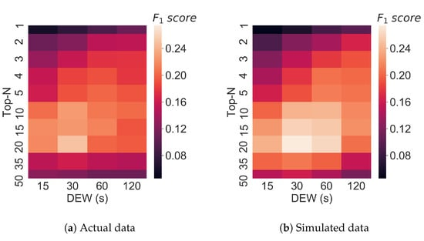
Optimising Top-N
We compared performance of our ViMMS Top-N controller (simulated chemicals) vs machine Top-N (same real sample)
Results show simulations in ViMMS closely match the real performance
Wandy, J., Davies, V., et al. (2019). In silico optimization of mass spectrometry fragmentation strategies in metabolomics. Metabolites.

Slide 48
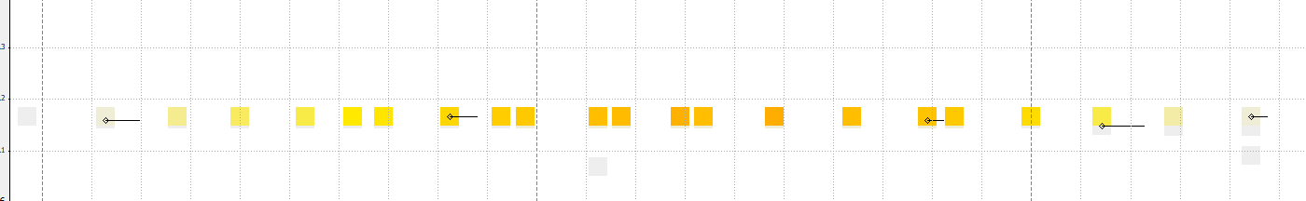
Developing new DDA methods
We can also develop new methods
We motivated our methods to avoid repeated fragmentation events (e.g. below)
We can then compare them against Top-N
Davies, V., et al. (2021). Rapid development of improved data-dependent acquisition strategies. Analytical chemistry.

Slide 49
Problem
Double bombing / fragmenting is a major problem
 | 1 | 2 | 3 | 4 | 5 | 6 | 7 | 8 | 9 | 10
A
B
C
D
E
F
G
H
I
J
Generally, hitting a ship twice does not help us

Slide 50
Problem
Double bombing / fragmenting is a major problem
 | 1 | 2 | 3 | 4 | 5 | 6 | 7 | 8 | 9 | 10
A
B
C
D
E
F
G
H
I
J
We could have moved the second bomb to here

Slide 51
Problem
Double bombing / fragmenting is a major problem
 | 1 | 2 | 3 | 4 | 5 | 6 | 7 | 8 | 9 | 10
A
B
C
D
E
F
G
H
I
J
We could have moved the second bomb to here

Slide 52
Next Problem
Simple solutions become problematic if there are 2 ships together
 | 1 | 2 | 3 | 4 | 5 | 6 | 7 | 8 | 9 | 10
A
B
C
D
E
F
G
H
I
J

Slide 53
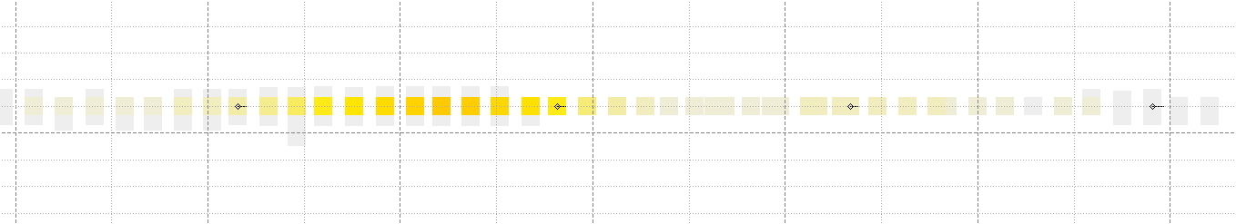
Next Problem

Slide 54
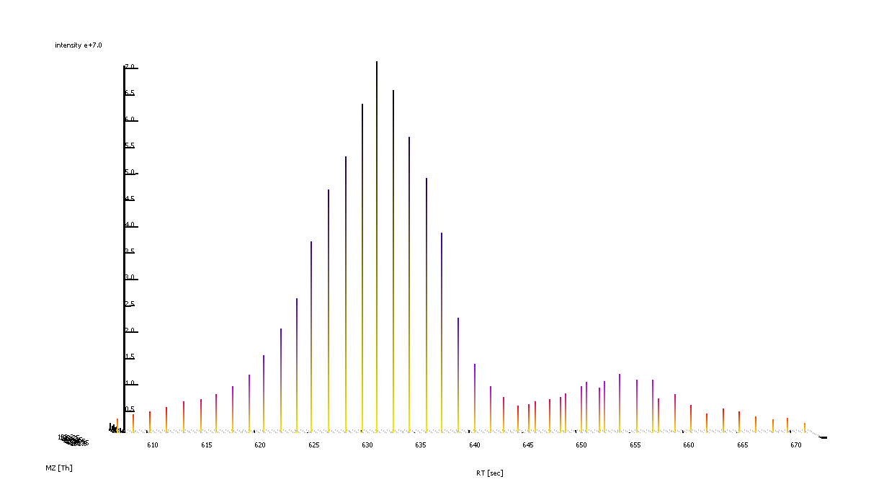
Next Problem

Slide 55
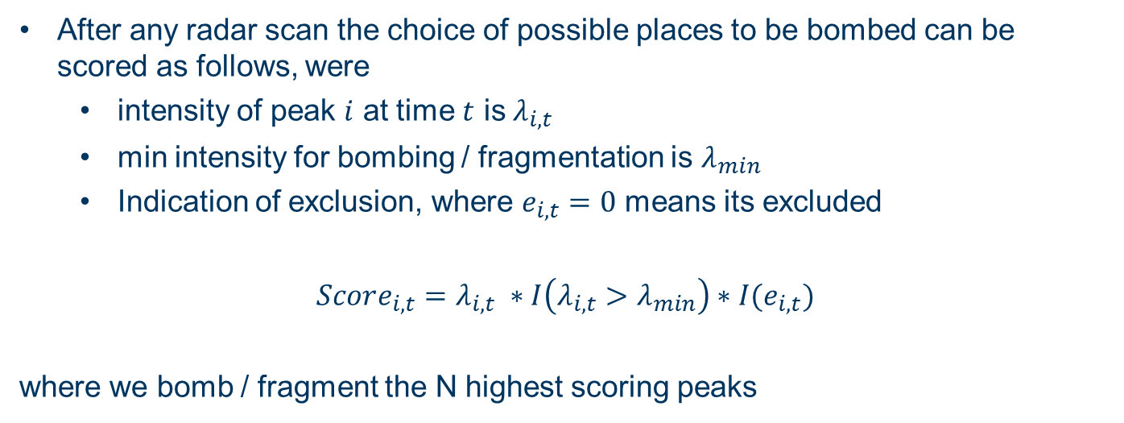
Top-N Scoring System
After any radar scan the choice of possible places to be bombed can be scored as follows, were
intensity of peak $i$ at time $t$ is $λ_{i,t}$
min intensity for bombing / fragmentation is $λ_{min}$
Indication of exclusion, where $e_{i,t}=0$ means its excluded
$$Score_{i,t}=λ_{i,t} ∗I\left(λ_{i,t}>λ_{min}\right)∗I(e_{i,t})$$
where we bomb / fragment the N highest scoring peaks

Slide 56
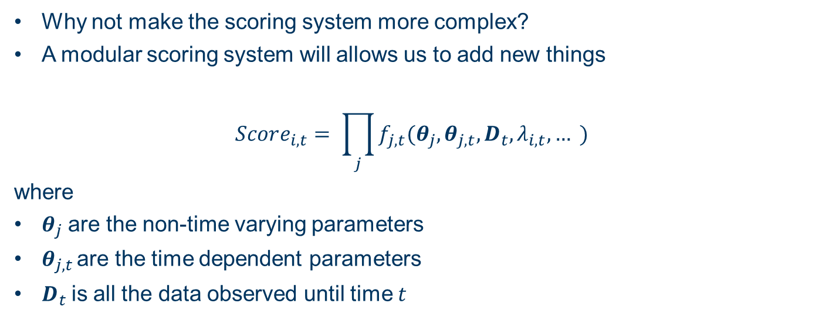
Generic Scoring System
Why not make the scoring system more complex?
A modular scoring system will allows us to add new things
$$Score_{i,t}= \prod_{j}{f_{j,t}(θ_{j}, θ_{j,t}, D_{t}, λ_{i,t},… )}$$
where
$θ_{j}$ are the non-time varying parameters
$θ_{j,t }$are the time dependent parameters
$D_{t}$is all the data observed until time $t$

Slide 57
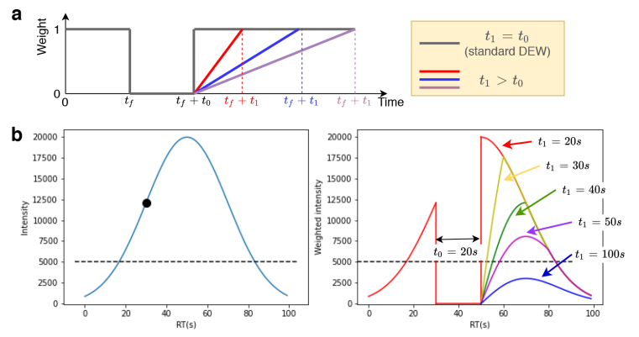

Davies, V., et al. (2021). Rapid development of improved data-dependent acquisition strategies. Analytical chemistry.
WeightedDEW
$$Score_{i,t}=λ_{i,t} ∗I\left(λ_{i,t}>λ_{min}\right)∗f(e_{i,t},t_{0}, t_{1})$$

Slide 58
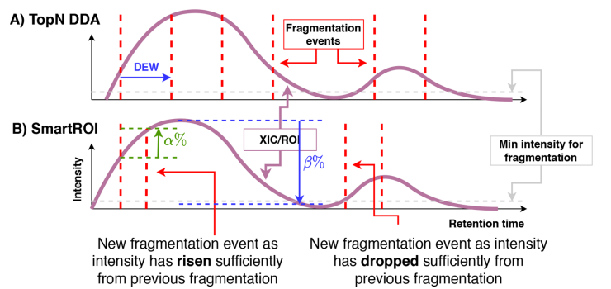

Davies, V., et al. (2021). Rapid development of improved data-dependent acquisition strategies. Analytical chemistry.
SmartROI
$$Score_{i,t}=λ_{i,t} ∗I\left(λ_{i,t}>λ_{min}\right)∗f(e_{i,t},α, β)$$

Slide 59
In-Silico Development in ViMMS
ViMMS allowed us to develop and debug these methods before ever using samples or machine time
We then optimised the parameters of the methods to maximise peak coverage (or any other metric you choose)

Slide 60
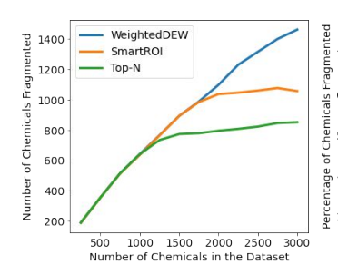
In-Silico Validation in ViMMS
We then tested them out in different simulated scenarios in ViMMS
Big increase in performance when there are a large number of metabolites (peaks)

Slide 61
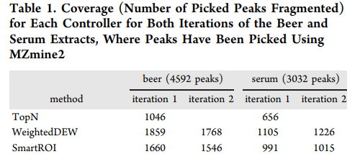
Real Experimental Validation
We then tested the methods on real samples (beer and serum)
Results showed a 50%+ increase in performance
Davies, V., et al. (2021). Rapid development of improved data-dependent acquisition strategies. Analytical chemistry.

Slide 62
What about multi sample DDA methods?
Under the same principles, we can also develop multi-sample DDA methods and test existing ones, e.g. DsDA, MSplanner

Slide 63
BEFORE the FIRST sample
Let’s take the original example
 | 1 | 2 | 3 | 4 | 5 | 6 | 7 | 8 | 9 | 10
A
B
C
D
E
F
G
H
I
J

Slide 64
AFTER the FIRST sample
Use the same simple strategy on the first sample
 | 1 | 2 | 3 | 4 | 5 | 6 | 7 | 8 | 9 | 10
A
B
C
D
E
F
G
H
I
J

Slide 65
Example: Identical Samples
If samples are the same, we just avoid bombing sunk ships
 | 1 | 2 | 3 | 4 | 5 | 6 | 7 | 8 | 9 | 10
A
B
C
D
E
F
G
H
I
J

Slide 66
Example: Identical Samples
If samples are the same, we just avoid bombing sunk ships
Put exclusion regions round sunken ships
 | 1 | 2 | 3 | 4 | 5 | 6 | 7 | 8 | 9 | 10
A
B
C
D
E
F
G
H
I
J

Slide 67
Example: Identical Samples
If samples are the same, we just avoid bombing sunk ships
Put exclusion regions round sunken ships
Then run the same strategy again
 | 1 | 2 | 3 | 4 | 5 | 6 | 7 | 8 | 9 | 10
A
B
C
D
E
F
G
H
I
J

Slide 68
Example: Changing Ships
What happens if the ships change?
Possible strategies:
Use Top-N again (will bomb sunken ships, but potentially also bomb new ships)
Use Top-N with exclusions

Slide 69
Example: Different Samples (Top-N Exclusion)
Exclusion regions are still around sunk ships, regardless if they are in this sample
Then run the same strategy again
 | 1 | 2 | 3 | 4 | 5 | 6 | 7 | 8 | 9 | 10
A
B
C
D
E
F
G
H
I
J

Slide 70
Example: Different Samples (Top-N Exclusion)
 | 1 | 2 | 3 | 4 | 5 | 6 | 7 | 8 | 9 | 10
A
B
C
D
E
F
G
H
I
J
We can hit this ship we missed before

Slide 71
Example: Different Samples (Top-N Exclusion)
 | 1 | 2 | 3 | 4 | 5 | 6 | 7 | 8 | 9 | 10
A
B
C
D
E
F
G
H
I
J

Slide 72
Example: Different Samples (Top-N Exclusion)
 | 1 | 2 | 3 | 4 | 5 | 6 | 7 | 8 | 9 | 10
A
B
C
D
E
F
G
H
I
J
We see a new ship, but its in an excluded region, so we don’t bomb it
This ship isn’t in this convoy / sample anymore, so we have missed it completely

Slide 73
Example: Different Samples (Top-N Exclusion)
 | 1 | 2 | 3 | 4 | 5 | 6 | 7 | 8 | 9 | 10
A
B
C
D
E
F
G
H
I
J
We can bomb this new ship

Slide 74
Example: Different Samples (Top-N Exclusion)
 | 1 | 2 | 3 | 4 | 5 | 6 | 7 | 8 | 9 | 10
A
B
C
D
E
F
G
H
I
J
It gets sunk

Slide 75
Example: Changing Ships
What happens if the ships change?
Possible strategies:
Use Top-N again (will bomb sunken ships, but potentially also bomb new ships)
Use Top-N with exclusions
Use a pre-scheduling method (works well on identical samples)

Slide 76
Example: Different Samples (Pre-Scheduling)
Pre-scheduling takes no notice of radar scans which are included for post processing
There is no excluded regions, but those parts also never get scheduled
 | 1 | 2 | 3 | 4 | 5 | 6 | 7 | 8 | 9 | 10
A
B
C
D
E
F
G
H
I
J

Slide 77
Example: Different Samples (Pre-Scheduling)
 | 1 | 2 | 3 | 4 | 5 | 6 | 7 | 8 | 9 | 10
A
B
C
D
E
F
G
H
I
J
We saw this ship in sample 1 and didn’t sink it, so we can bomb it this time

Slide 78
Example: Different Samples (Pre-Scheduling)
 | 1 | 2 | 3 | 4 | 5 | 6 | 7 | 8 | 9 | 10
A
B
C
D
E
F
G
H
I
J
We assume this ship is still there and bomb the water…

Slide 79
Example: Different Samples (Pre-Scheduling)
 | 1 | 2 | 3 | 4 | 5 | 6 | 7 | 8 | 9 | 10
A
B
C
D
E
F
G
H
I
J
We can’t adjust to new ships, so we just ignore this one…

Slide 80
Example: Changing Ships
What happens if the ships change?
Possible strategies:
Use Top-N again (will bomb sunken ships, but potentially also bomb new ships)
Use Top-N with exclusions
Use a pre-scheduling method (works well on identical samples)
Design a new method which can adjust on the fly

Slide 81
TopNEXt: Automated Exclusion
TopNEXt is a modular framework for multi-sample acquisition
It scores possible MS2 scans based on previously observed scans in the current and previous samples
McBride, R., …, Davies, V., … et al. (2023). TopNEXt: Automatic DDA Exclusion Framework for Multi-Sample Mass Spectrometry Experiments. bioRxiv (submitted to Bioinformatics).

Slide 82
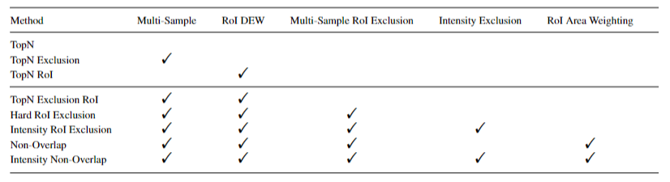
TopNEXt: Automated Exclusion
It contains a number of different options and can easily be extended
McBride, R., …, Davies, V., … et al. (2023). TopNEXt: Automatic DDA Exclusion Framework for Multi-Sample Mass Spectrometry Experiments. bioRxiv (submitted to Bioinformatics).

Slide 83
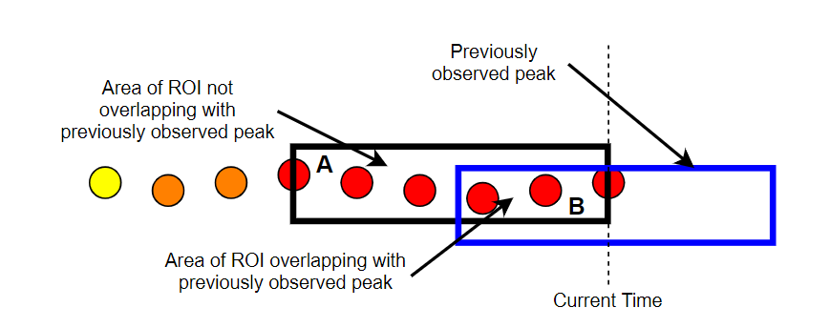
Non-Overlap
Beyond the framework, it also introduces the concept of (non-)overlap
It looks at how much a current ROI (black) overlaps with a previous ROI (blue) and scores it based on how much they overlap
The more it overlaps with a fragmented previous ROI, the lower it will be scored
There is also a version based on the intensity of the previous MS2 scans

Slide 84
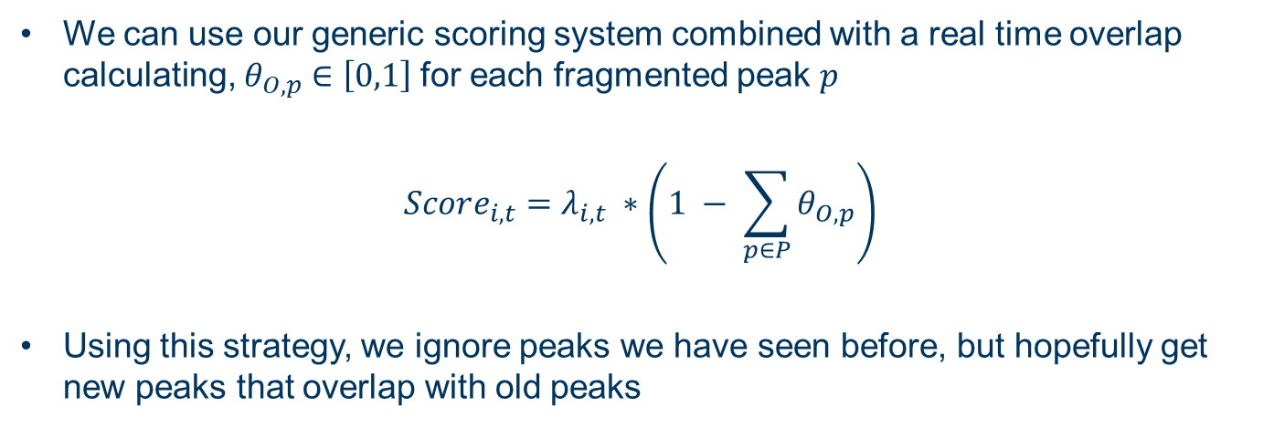
Non-Overlap
We can use our generic scoring system combined with a real time overlap calculating, $θ_{O,p}∈\left[0,1\right]$for each fragmented peak $p$
$$Score_{i,t}=λ_{i,t} ∗\left(1 − \sum_{p∈P}{θ_{O,p}}\right)$$
Using this strategy, we ignore peaks we have seen before, but hopefully get new peaks that overlap with old peaks

Slide 85
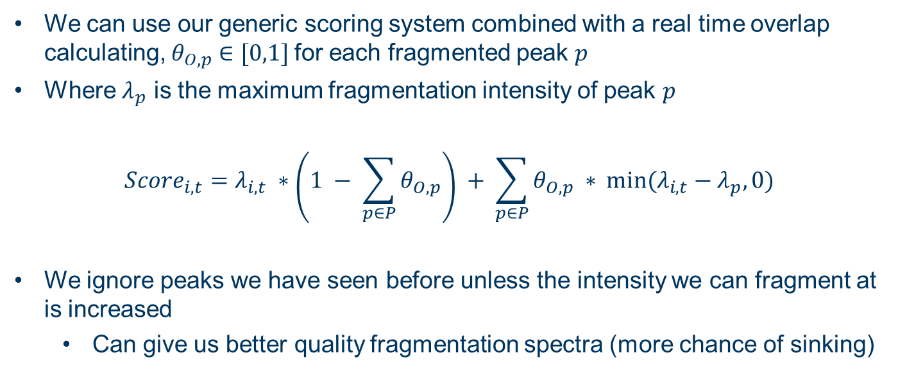
Intensity Non-Overlap
We can use our generic scoring system combined with a real time overlap calculating, $θ_{O,p}∈[0,1]$for each fragmented peak $p$
Where $λ_{p}$ is the maximum fragmentation intensity of peak $p$
$$Score_{i,t}=λ_{i,t} ∗\left(1 − \sum_{p∈P}{θ_{O,p}}\right) + \sum_{p∈P}{θ_{O,p} ∗ }min(λ_{i,t}−λ_{p}, 0)$$
We ignore peaks we have seen before unless the intensity we can fragment at is increased
Can give us better quality fragmentation spectra (more chance of sinking)

Slide 86
Example: Different Samples (Non-Overlap)
We believe that Non-Overlap gives us the best of both worlds
Its hard to demonstrate on this example
 | 1 | 2 | 3 | 4 | 5 | 6 | 7 | 8 | 9 | 10
A
B
C
D
E
F
G
H
I
J

Slide 87
Example: Different Samples (Non-Overlap)
This is what I hope happens in this example…
 | 1 | 2 | 3 | 4 | 5 | 6 | 7 | 8 | 9 | 10
A
B
C
D
E
F
G
H
I
J

Slide 88
Example: Different Samples (Non-Overlap)
This is what I hope happens in this example…
We still miss the peak that disappeared after the first raid
 | 1 | 2 | 3 | 4 | 5 | 6 | 7 | 8 | 9 | 10
A
B
C
D
E
F
G
H
I
J

Slide 89
Example: Different Samples (Non-Overlap)
This is what I hope happens in this example…
We still miss the peak that disappeared after the first raid
We can re-fragment new peaks
 | 1 | 2 | 3 | 4 | 5 | 6 | 7 | 8 | 9 | 10
A
B
C
D
E
F
G
H
I
J

Slide 90
Example: Different Samples (Non-Overlap)
This is what I hope happens in this example…
We still miss the peak that disappeared after the first raid
We can re-fragment new peaks
We can re-fragment old peaks with Intensity Non-Overlap
 | 1 | 2 | 3 | 4 | 5 | 6 | 7 | 8 | 9 | 10
A
B
C
D
E
F
G
H
I
J

Slide 91
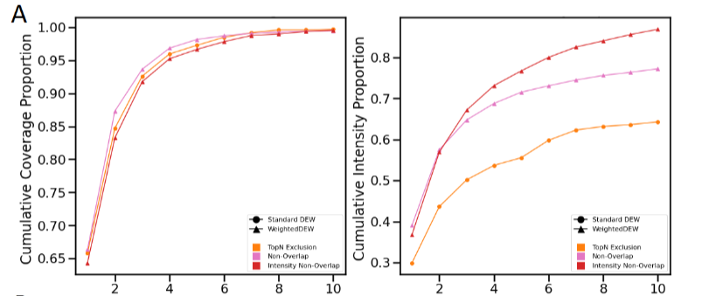
TopNEXt: Automated Exclusion

Slide 92
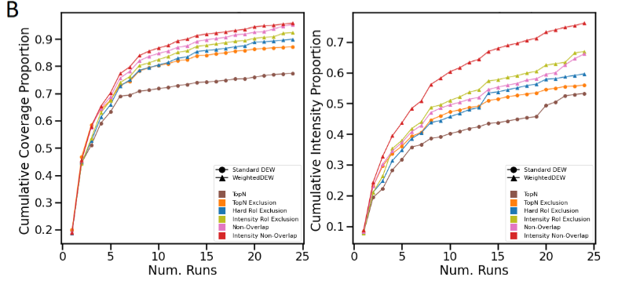
TopNEXt: Automated Exclusion

Slide 93
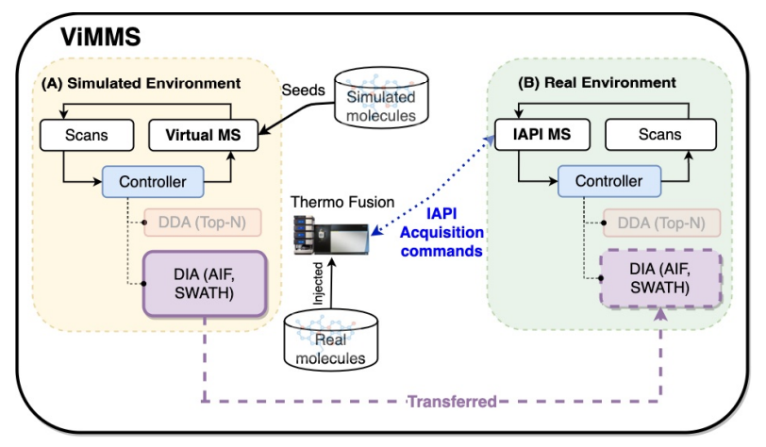
What about DIA?
We can similarly implement DIA in ViMMS (and eventually TopNEXt)

Slide 94
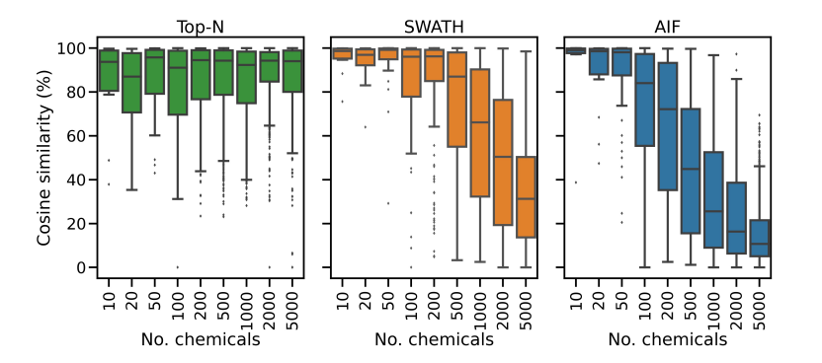
DIA vs DDA
We have implemented SWATH and AIF within ViMMS
Compared them against DDA

Slide 95
Bottleneck of DIA?
We can construct our own DIA methods or even hybrid DDA-DIA methods
Limitation appears to be the deconvolution
Generally inflexible
Low accuracy
Overly correlated predicted spectra
ViMMS allows us to properly evaluate deconvolution and we have began designing our own method
I see this as the immediate application of ViMMS
Wandy, J., ... & Davies, V. (2023). Simulated-to-real Benchmarking of Acquisition Methods in Untargeted Metabolomics. Frontiers in Molecular Biosciences.

Slide 96
Any questions?
Big thank you to all my collaborators:
University of Glasgow: Joe Wandy, Rónán Daly, Simon Rogers, Ross McBride, Kevin Bryson, Stefan Weidt, Nikolaos Terzis, Alice Miller
Wageningen University: Justin J.J. van der Hooft
Ideas for ViMMS or any further questions
Email: vinny.davies@glasgow.ac.uk
Twitter: vinny_davies89
Slides available at:
https://github.com/vinnydavies/presentations

